Slide 1
Advanced Discrete Event Simulation in R
TA Trikalinos
(joint work with F Alarid-Escudero, Y Sereda, SA Chrysanthopoulou)
CISNET, 28/05/2025

Slide 2
Disclosures
No financial or other conflicts
Supported by the NCI CISNET Incubator (bladder, all) and CISNET programs (colorectal - FAE)
Trikalinos and Sereda developed and maintain the nhppp R package
Half day course at SMDM 2025 – Take it, it’s all fun and games.

Slide 3
Outline
Discrete event simulation as a convolution of point processes
Non-homogeneous Poisson point processes (NHPPPs)
Sampling from NHPPPs
Demonstration

Slide 4
Outline
Discrete event simulation as a convolution of point processes
Non-homogeneous Poisson point processes (NHPPPs)
Sampling from NHPPPs
Demonstration

Slide 5
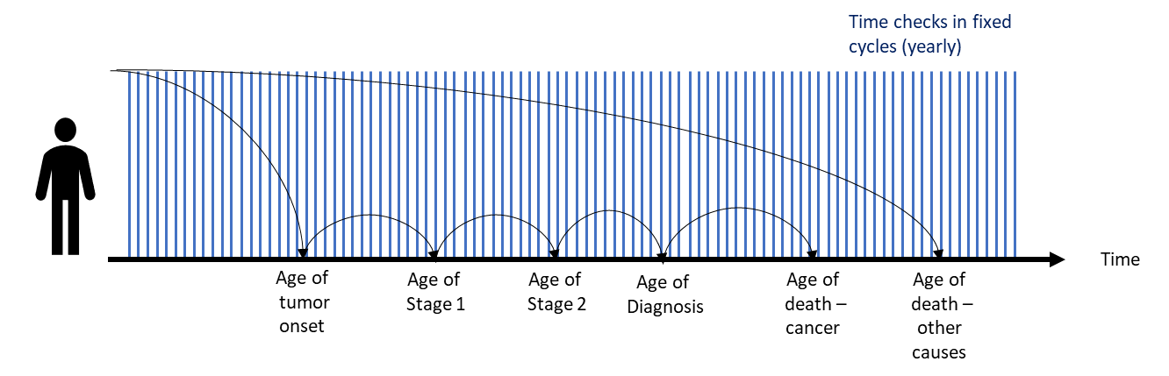
Background
Discrete-time simulation samples events in each cycle
Discrete-time simulation
Thanks to Carlos Pineda
Notes:
or even the time when they died

Slide 6
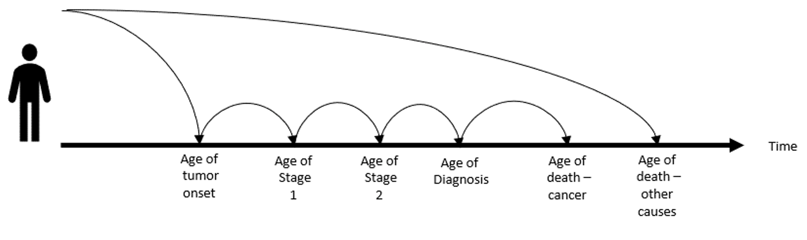
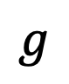
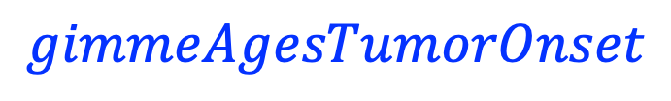
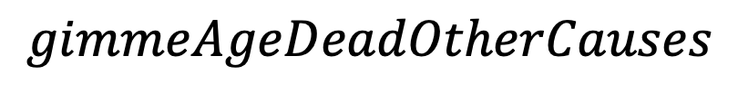
Background
Discrete-event simulation works with event-generating processes
$$g$$
$$gimmeAgeDeadOtherCauses$$
$$gimmeAgesTumorOnset$$
Thanks to Carlos Pineda

Slide 7
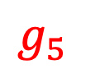
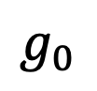
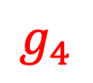
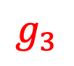
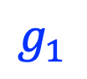
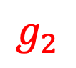
Background
Discrete-event simulation works with event-generating processes
$$g_{0}$$
$$g_{1}$$
$$g_{2}$$
$$g_{3}$$
$$g_{4}$$
$$g_{5}$$
Thanks to Carlos Pineda

Slide 8
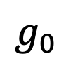
A typology of event-generating processes
start being
at risk
stop being
at risk
Black process:
Exactly 1 event
$$g_{0}$$
simulation window
Red process:
At most 1 event
$$g_{1}$$
$$g_{2}$$
$$g_{3}$$
$$g_{4}$$
$$g_{5}$$
Blue process:
0, 1, … events
Thanks to Carlos Pineda

Slide 9



The building blocks of a DES
start being
at risk
stop being
at risk
Events that happen exactly once
Events that happen 0 or 1 times
Events that happen 0, 1, … times
event

Slide 10
Graphical notation: Chained events (in series)
For chained processes, the next one starts once the preceding one realizes an event.
imagine simulating the first row first, etc.

Slide 11
Graphical notation: Competing events (parallel)
Competing event processes run parallel to each other.

Slide 12
A simple DES model
All shall die.
Some may develop a cancer.
Some cancers will
be clinically diagnosed, or
cause deaths

Slide 13
Outline
Discrete event simulation as a convolution of point processes
Non-homogeneous Poisson point processes (NHPPPs)
Sampling from NHPPPs
Demo

Slide 14
The building block

Slide 15
The point process
A scheme that generates a sequence of events (points) over a time interval
interval of interest

Slide 16
The point process
A scheme that generates a sequence of events (points) over time
An instantiation (trajectory) of the process is a sequence of 0, 1 or more events in the interval, but none outside it
events or points,
(same thing)
interval of interest

Slide 17
The point process
A scheme that generates a sequence of events (points) over time
Each instantiation is random
another instantiation (trajectory)

Slide 18
The point process
A scheme that generates a sequence of events (points) over time
Each instantiation is random
another instantiation
(with no events)

Slide 19
The point process
A scheme that generates a sequence of events (points) over time
Each instantiation is random
yet another instantiation

Slide 20
The point process
The arrival times (times of the events) are random
They start from whenever we zeroed the clock
arrival times

Slide 21
The point process
The interarrival times are the lengths of the interarrival time intervals
The arrival times and interarrival times give the same information (… thus, the interarrival times are random)
interarrival intervals

Slide 22
The point process
Hereon, we refer only to arrival times
interarrival intervals
arrival times

Slide 23
Modeling non-repeatable events
If the point process models a nonrepeatable event, we care only about the earliest event.
Will it occur in the interval, and, and if so, when?
Example: model a cause of death
ignore these events
(they are undefined –
they have no meaning)
earliest event

Slide 24
Modeling repeatable events
If the point process models a repeatable event, we care are about all events.
Will any occur in the interval, and, and if so, when?
Example: model the emergence of tumors, or the start of symptomatic episodes
all events are defined – all events have a meaning

Slide 25
The Poisson point process
There are many types of point processes
We will consider only a one type – the Poisson point process

Slide 26
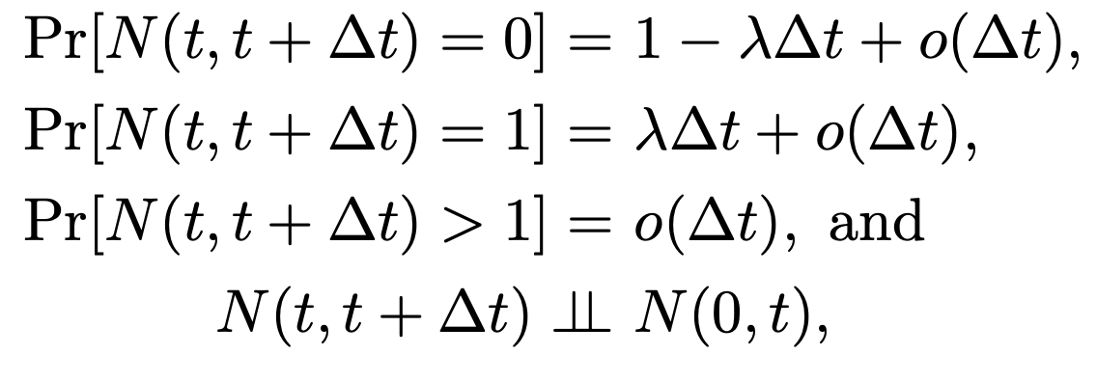
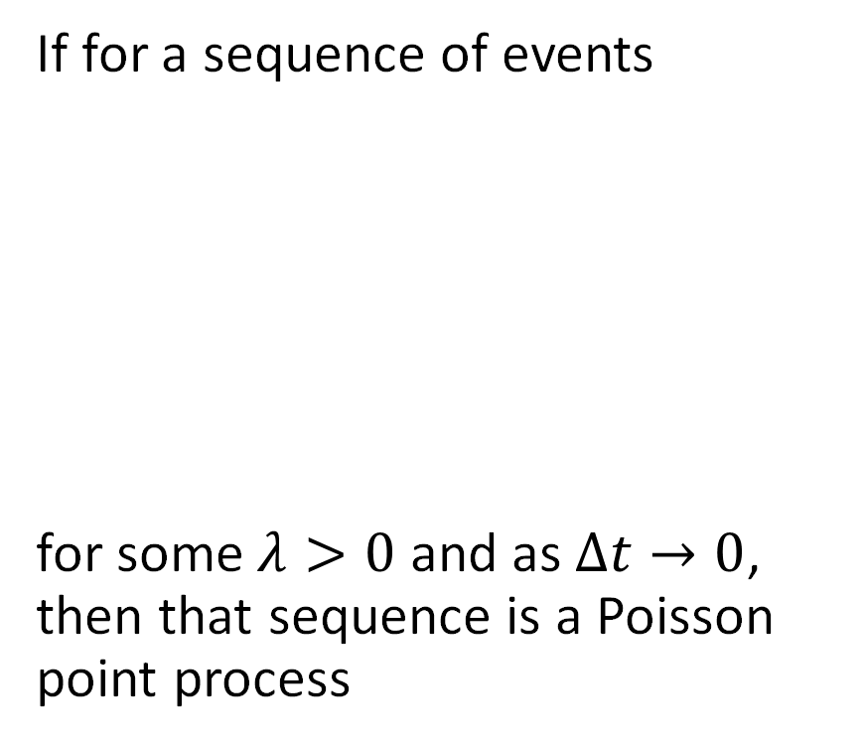
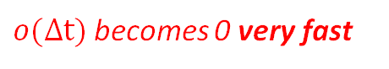
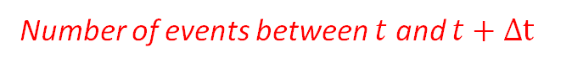
The Poisson point process
Number of events between $t$ and $t+Δt$
If for a sequence of events
for some $λ>0$ and as $Δt→0$, then that sequence is a Poisson point process
$o(Δt)$ becomes 0 very fast

Slide 27
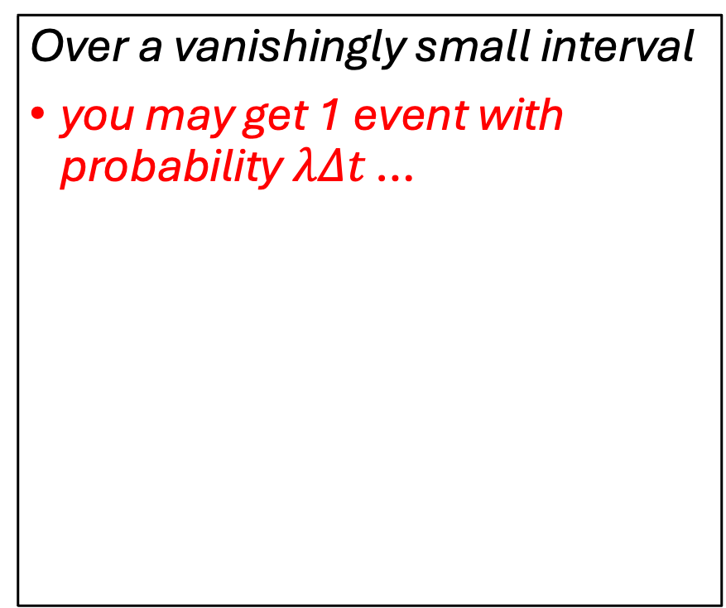
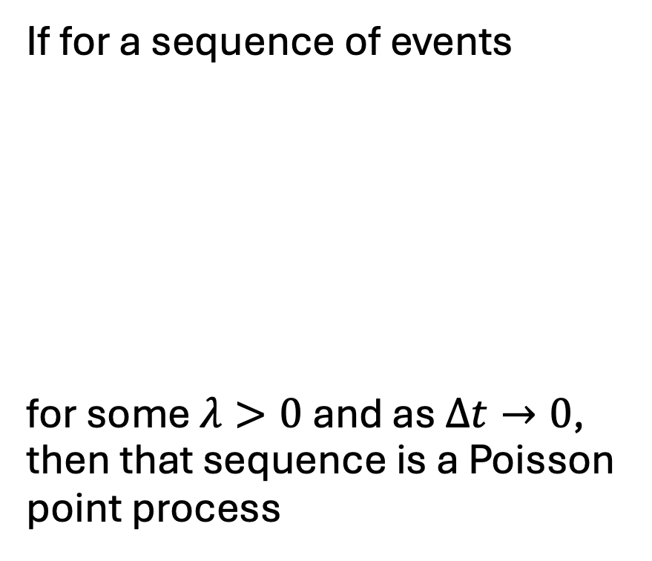
The Poisson point process (in English)
If for a sequence of events
for some $λ>0$ and as $Δt→0$, then that sequence is a Poisson point process
Over a vanishingly small interval
you may get 1 event with probability $λΔt$ …
0

Slide 28
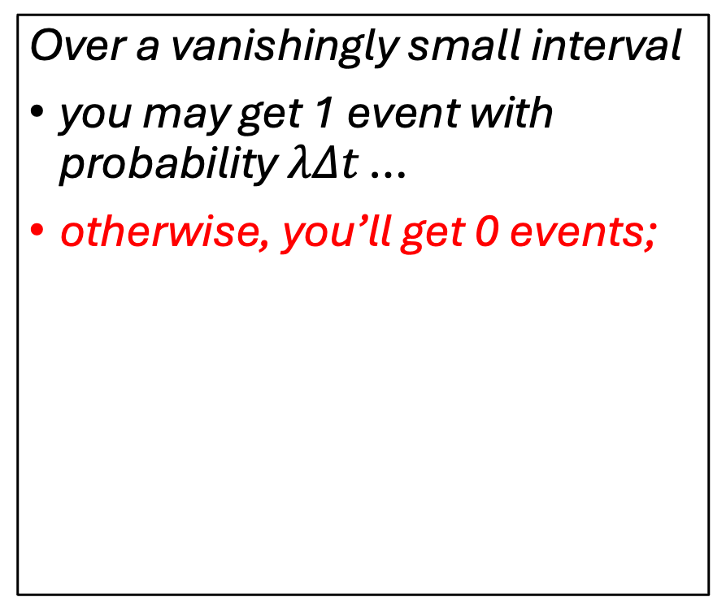
The Poisson point process (in English)
If for a sequence of events
for some $λ>0$ and as $Δt→0$, then that sequence is a Poisson point process
Over a vanishingly small interval
you may get 1 event with probability $λΔt$ …
otherwise, you’ll get 0 events;
0

Slide 29
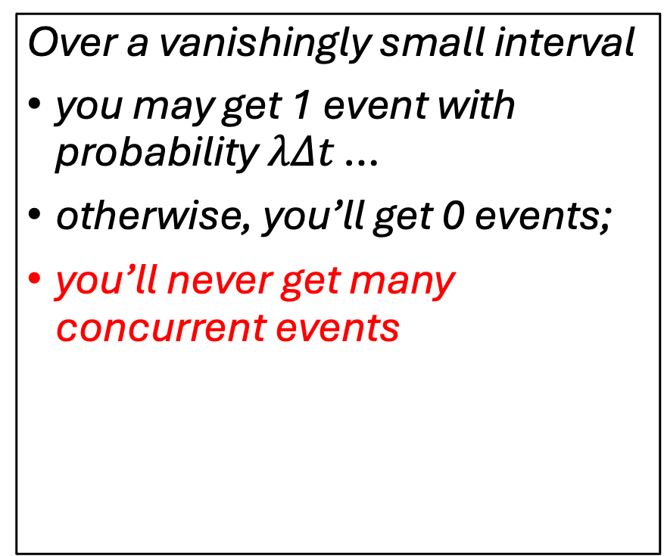
The Poisson point process (in English)
If for a sequence of events
for some $λ>0$ and as $Δt→0$, then that sequence is a Poisson point process
Over a vanishingly small interval
you may get 1 event with probability $λΔt$ …
otherwise, you’ll get 0 events;
you’ll never get many concurrent events
0

Slide 30
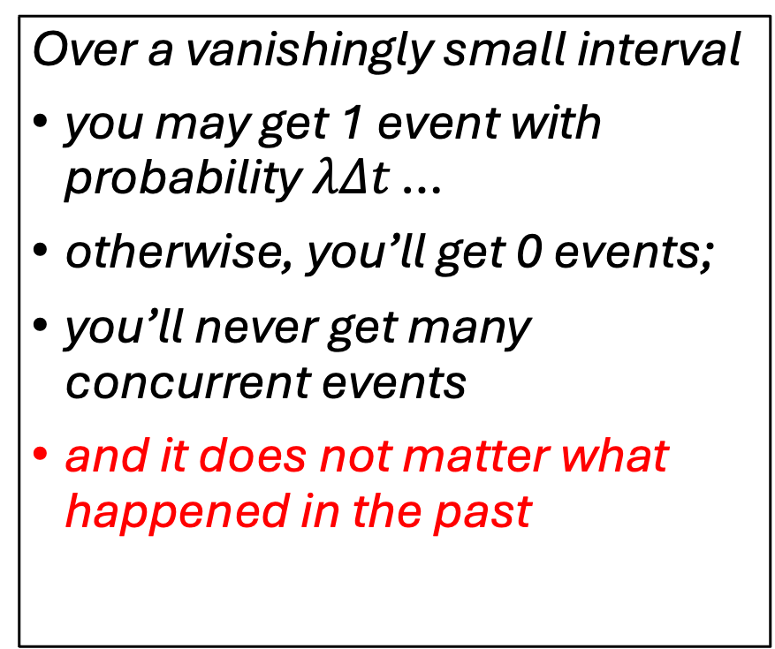
The Poisson point process (in English)
If for a sequence of events
for some $λ>0$ and as $Δt→0$, then that sequence is a Poisson point process
Over a vanishingly small interval
you may get 1 event with probability $λΔt$ …
otherwise, you’ll get 0 events;
you’ll never get many concurrent events
and it does not matter what happened in the past
0

Slide 31

The intensity function $λ$ in the example
Event times for five instantiations

Slide 32
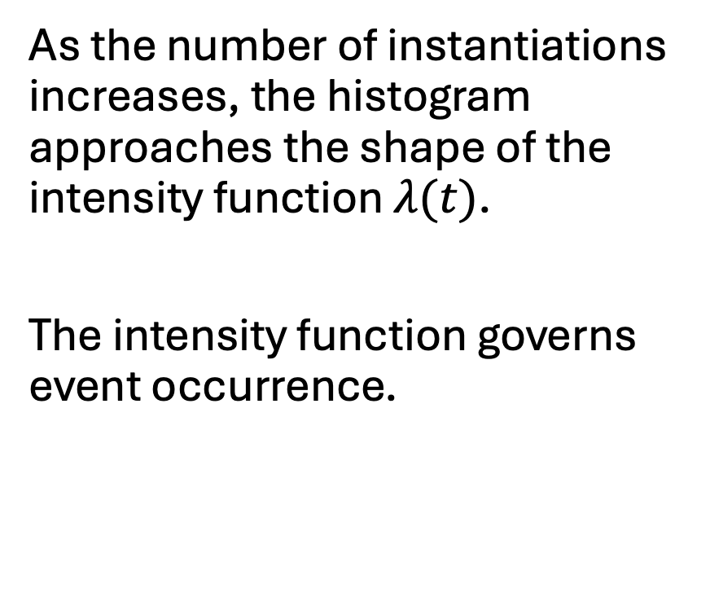
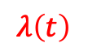
The intensity function $λ$ in the example
As the number of instantiations increases, the histogram approaches the shape of the intensity function $λ(t)$.
The intensity function governs event occurrence.
$$λ\left(t\right)$$
The intensity function is scaled by the expected number of events in the interval to be on the same plot

Slide 33
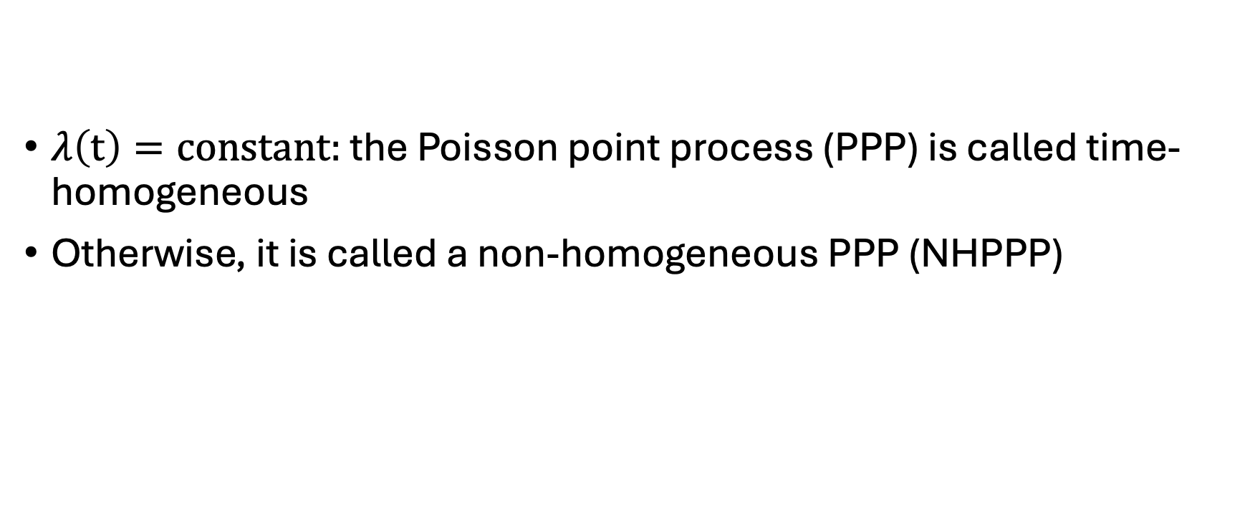
Time-homogeneous and non-homogeneous
$λ\left(t\right)=constant:$ the Poisson point process (PPP) is called time-homogeneous
Otherwise, it is called a non-homogeneous PPP (NHPPP)

Slide 34
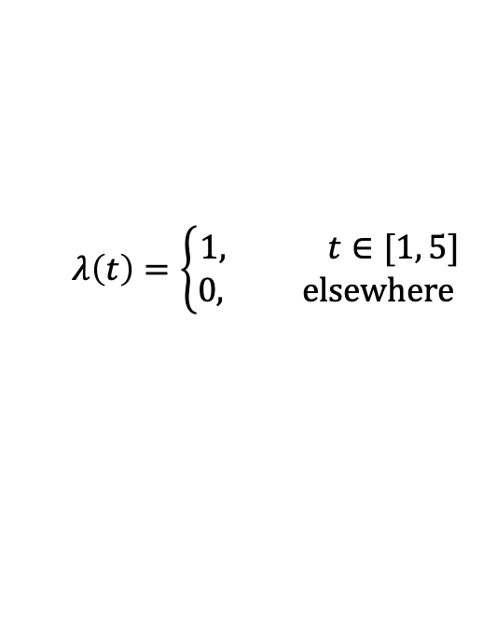
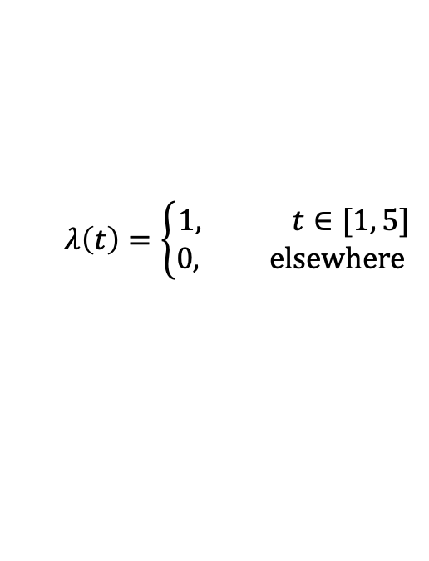
All events vs earliest event in the example
All events, 10K instantiations
Earliest event, 10K instantiations
$$λ\left(t\right)=\left\{\begin{aligned}1, t∈[1, 5] \\ &0, elsewhere \end{aligned}\right.$$
$$λ\left(t\right)=\left\{\begin{aligned}1, t∈[1, 5] \\ &0, elsewhere \end{aligned}\right.$$
The histogram of the earliest event times does not approach the shape of the intensity function

Slide 35
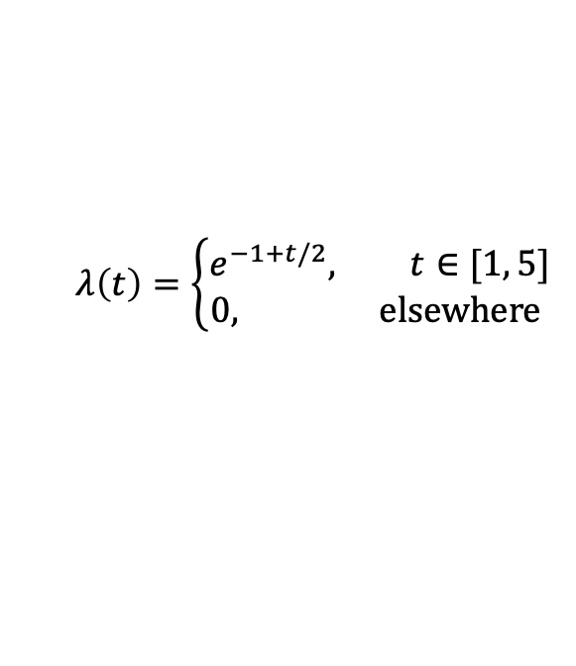
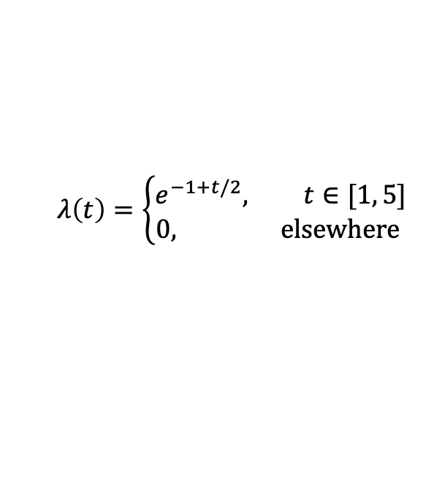
All events vs earliest event, different example
All events, 100K instantiations
Earliest event, 100K instantiations
$$λ\left(t\right)=\left\{\begin{aligned}e^{−1+t/2}, t∈[1, 5] \\ &0, elsewhere \end{aligned}\right.$$
$$λ\left(t\right)=\left\{\begin{aligned}e^{−1+t/2}, t∈[1, 5] \\ &0, elsewhere \end{aligned}\right.$$

Slide 36
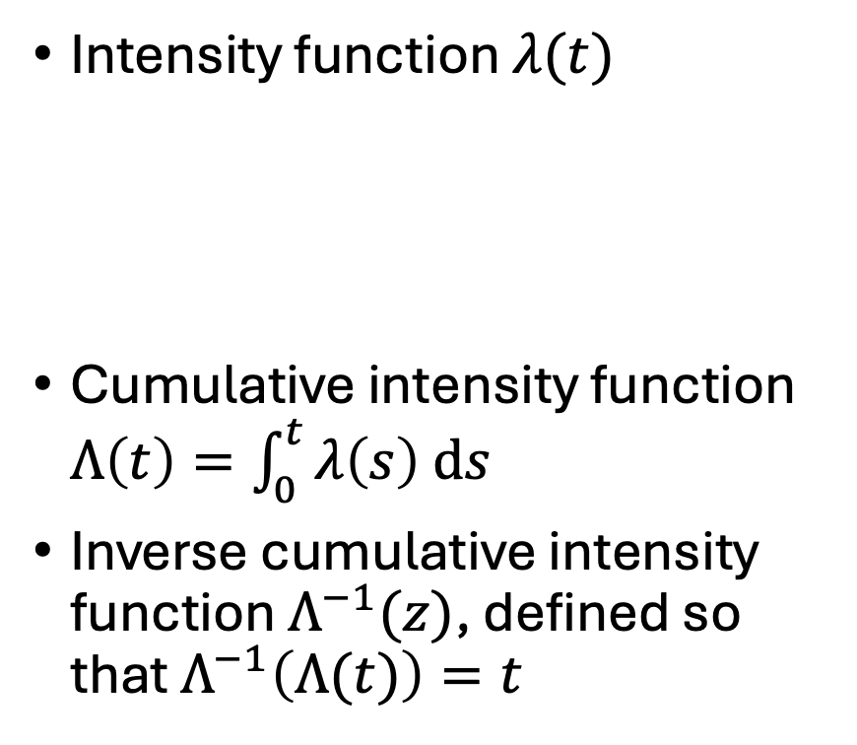
The three important functions
Intensity function $λ(t)$
Cumulative intensity function $Λ\left(t\right)=\int_{0}^{t}{λ\left(s\right) ds}$
Inverse cumulative intensity function $Λ^{−1}(z)$, defined so that $Λ^{−1}\left(Λ(t)\right)=t$
Always available
Sufficient to sample from any NHPPP efficiently and accurately
Not always available
If available, you accelerate sampling by several times

Slide 37

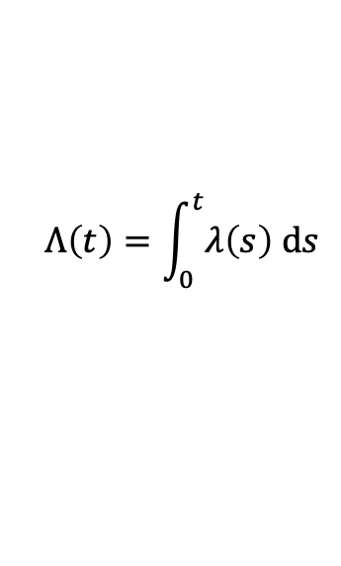
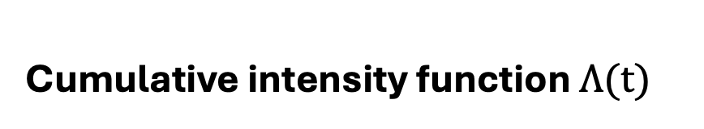
Intensity and cumulative intensity functions
Intensity function $λ(t)$
Cumulative intensity function $Λ(t)$
$$Λ\left(t\right)=\int_{0}^{t}{λ\left(s\right) ds}$$

Slide 38
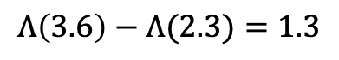
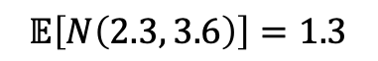
Intensity and cumulative intensity functions
Intensity function $λ(t)$
Cumulative intensity function $Λ(t)$
$$Λ\left(3.6\right)−Λ(2.3)=1.3$$
$$𝔼\left[N\left(2.3, 3.6\right)\right]=1.3$$

Slide 39
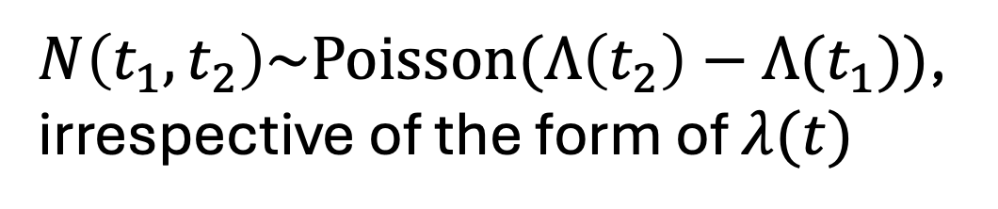
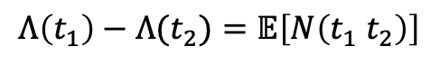
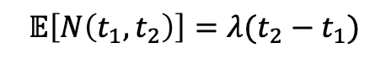
Intensity and cumulative intensity functions
$N\left(t_{1}, t_{2}\right)\sim Poisson(Λ\left(t_{2}\right)−Λ(t_{1}))$,
irrespective of the form of $λ(t)$
$$Λ\left(t_{1}\right)−Λ(t_{2})=𝔼\left[N\left(t_{1} t_{2}\right)\right]$$
$$𝔼\left[N\left(t_{1}, t_{2}\right)\right]=λ(t_{2}−t_{1})$$

Slide 40
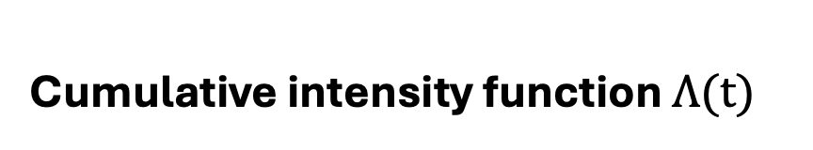
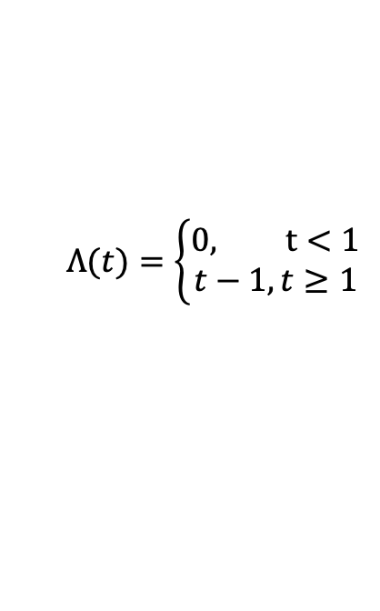
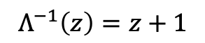
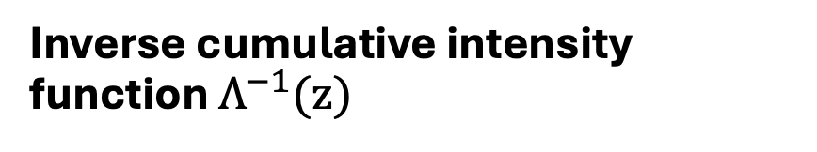
Cumulative intensity function and its inverse
Cumulative intensity function $Λ(t)$
Inverse cumulative intensity function $Λ^{−1}(z)$
$$Λ(t)=\left\{\begin{aligned}&0, t<1 \\ t−1,t≥1\end{aligned}\right.$$
$$Λ^{−1}\left(z\right)=z+1$$

Slide 41
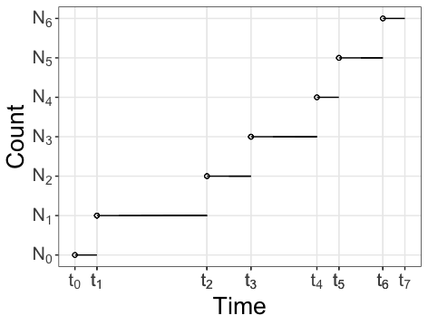

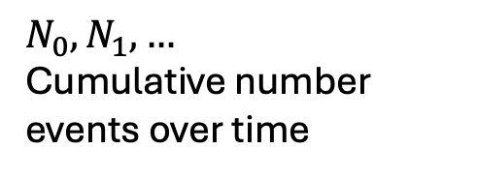
Duality with the Poisson counting process
Poisson counting process
$$N_{0}, N_{1}, …$$
Cumulative number events over time
Poisson point process
$$t_{0}, t_{1},…$$

Slide 42
Outline
Discrete event simulation as a convolution of point processes
Non-homogeneous Poisson point processes (NHPPPs)
Sampling from NHPPPs
Demonstration

Slide 43
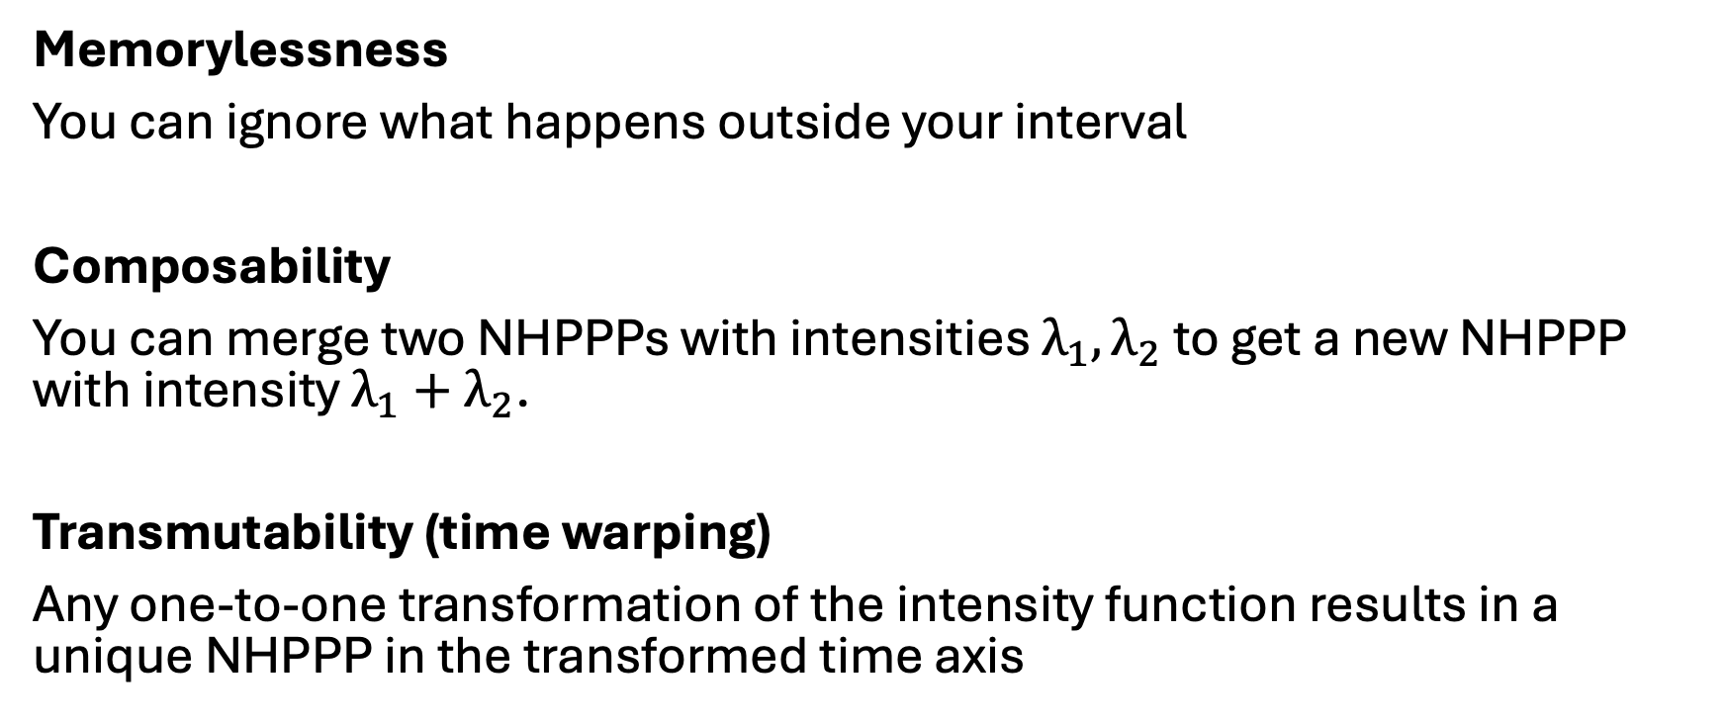
Three important properties for sampling
Memorylessness
You can ignore what happens outside your interval
Composability
You can merge two NHPPPs with intensities $λ_{1}, λ_{2}$ to get a new NHPPP with intensity $λ_{1}+λ_{2}$.
Transmutability (time warping)
Any one-to-one transformation of the intensity function results in a unique NHPPP in the transformed time axis

Slide 44
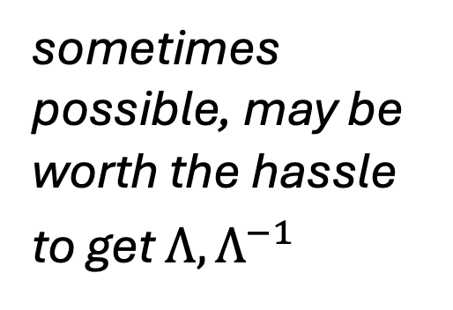
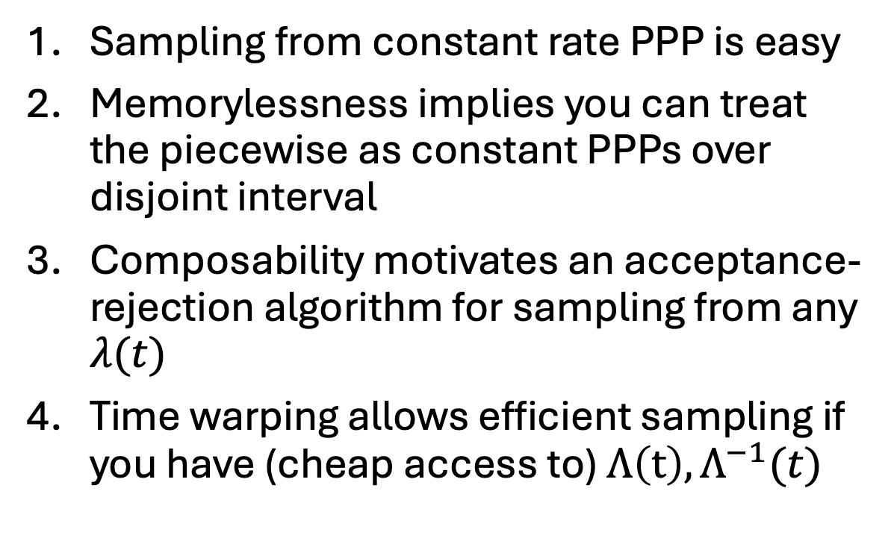
Overview of the sampling strategy
Sampling from constant rate PPP is easy
Memorylessness implies you can treat the piecewise as constant PPPs over disjoint interval
Composability motivates an acceptance-rejection algorithm for sampling from any $λ(t)$
Time warping allows efficient sampling if you have (cheap access to) $Λ\left(t\right), Λ^{−1}(t)$
easy
peasy
almost always practical
sometimes
possible, may be worth the hassle
to get $Λ, Λ^{−1}$

Slide 45
1. Sampling from a PPP is easy

Slide 46
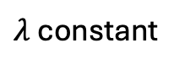
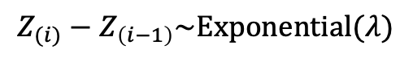
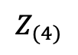
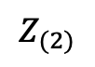
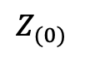

Constant intensity function (homogeneous PPP)
Sampling from a constant intensity function is easy.
The interarrival times have an exponential distribution.
$λ$ constant
$$Z_{(i)}−Z_{\left(i−1\right)}\sim Exponential(λ)$$
$$Z_{(0)}$$
$$Z_{(1)}$$
$$Z_{(2)}$$
$$Z_{(4)}$$

Slide 47
2. Memorylessness: Sampling from piecewise constant NHPPP is peasy

Slide 48
Piecewise constant intensity function (NHPPP)
Look at each piecewise constant interval separately
In each interval you have a constant intensity (easy)
Return the union of all events
Sampling from piecewise constant intensities is easy (memorylessness)

Slide 49


3. Composability: Sampling NHPPPs when you know $λ\left(t\right)$ reduces to sampling from a PPP (#1) or piecewise constant NHPPP (#2)*
* You still need to find a constant or piecewise constant majorizer $λ_{∗}\left(t\right)$, whose choice determines your efficiency .
You cannot get achieve something difficult with zero effort.
You will put in some work.
Other terms and conditions may apply.

Slide 50
Composability
+
=

Slide 51


NHPPP, where you know $λ\left(t\right)$ : Thinning
The general case is more challenging
$$λ\left(t\right)=e^{−1+0.5t}$$

Slide 52


NHPPP, where you know $λ\left(t\right)$ : Thinning
Find a majorizer function $λ_{∗}$ that’s easy to sample
Majorizer: any function that is “taller” that $λ$
$$λ_{∗}≥λ$$
(and has the same support as $λ$)
$$λ_{∗}\left(t\right)=5$$
$$λ\left(t\right)=e^{−1+0.5t}$$

Slide 53

NHPPP, where you know $λ\left(t\right)$ : Thinning
Find a majorizer function $λ_{∗}$ that’s easy to sample
$$λ_{∗}\left(t\right)=λ\left(t\right)+ \left[λ_{∗}\left(t\right)−λ(t)\right]$$
$$λ_{∗}\left(t\right)=5$$
$$λ\left(t\right)=e^{−1+0.5t}$$
Sample proposals from here
Keep proposals conforming to this part
Reject the rest

Slide 54

NHPPP, where you know $λ\left(t\right)$ : Thinning
Find a majorizer function $λ_{∗}$ that’s easy to sample
Draw events $\left\{Z_{∗1},…\right\}$ from $λ_{∗}$

Slide 55



NHPPP, where you know $λ\left(t\right)$ : Thinning
Find a majorizer function $λ_{∗}$ that’s easy to sample
Draw events $\left\{Z_{1},…\right\}$ from $λ_{∗}$
Accept event $i$ with probability $\frac{λ(Z_{i})}{λ_{∗}(Z_{i})}$
$${λ_{∗}(Z}_{\left[1\right]})$$
$${λ(Z}_{\left[1\right]})$$

Slide 56


NHPPP, where you know $λ\left(t\right)$: Thinning
Find a majorizer function $λ_{∗}$ that’s easy to sample
Draw events $\left\{Z_{∗1},…\right\}$ from $λ_{∗}$
Accept event $i$ with probability $\frac{λ(Z_{i})}{λ_{∗}(Z_{i})}$
The set of accepted points is an instantiation from $λ(t)$
(composability)

Slide 57

Thinning, efficiency
Thinning efficiency: average fraction of proposals that are accepted
Depends on the choice of $λ_{∗}$
The smaller the blue area, the better the efficiency
Efficiency = 32.9%

Slide 58
Thinning, efficiency
Thinning efficiency: average fraction of proposals that are accepted
Depends on the choice of $λ_{∗}$
The smaller the blue area, the better the efficiency
Efficiency = 36.7%

Slide 59
Thinning, efficiency
Thinning efficiency: average fraction of proposals that are accepted
Depends on the choice of $λ_{∗}$
The smaller the blue area, the better the efficiency
Efficiency = 78.7%

Slide 60


4. Transmutability of time: Sampling NHPPPs when you know $Λ, Λ^{−1}$ reduces to sampling from a PPP with rate one (#1) *
* You will need to do some maths to get $Λ,Λ^{−1}$. It may not be practical to do so, or even possible. In such a case, back to (#3). Even if you have $Λ$, you may not have a cheap $Λ^{−1}$. You cannot achieve something difficult with zero effort. You will put in some work. Other terms and conditions may apply.

Slide 61






Transmutability
$$u$$
$$u^{−1}$$
$$u(1)$$
$$u(2)$$
$$u(3)$$
$$u(3.5)$$

Slide 62
Transmutability
$$u$$
$$u^{−1}$$

Slide 63


A nice $u$ is $Λ$ (and then $u^{−1}$ is $Λ^{−1}$)
Change of variable from $s$ to $u$
$$Λ\left(t\right)= \int_{a}^{t}{λ\left(s\right) ds}=\int_{u(a)}^{u(t)}{\frac{λ\left(s\right)}{u′(s)} du}$$
Pick $u$ so that $u^{′}=λ.$ Any antiderivative of $λ$ works. Using $u≔Λ$, transforms time to scale where the process has constant rate 1,
$$\int_{Λ(a)}^{Λ(t)}{\frac{λ\left(s\right)}{Λ′(s)} du=\int_{Λ(a)}^{Λ(t)}{1 du}.}$$
This is a sketch of the formal proof – omitting the rigorous bits

Slide 64





Transmutability
1. Find the start and stop of the transformed time interval
$τ_{start}=Λ(t_{start})$ and $τ_{stop}=Λ(t_{stop})$
$$Λ$$
2. Sample transformed times from a PPP with constant rate one
$$\{τ_{\left(1\right)}, …\}$$
3. Back-transform the instantiation to the original time scale
$$\{Λ^{−1}\left(τ_{\left(1\right)}\right),…\}$$
$$Λ^{−1}$$

Slide 65




More in these works…

Slide 66
Outline
Discrete event simulation as a convolution of point processes
Non-homogeneous Poisson point processes (NHPPPs)
Sampling from NHPPPs
Demonstration

Slide 67


nhppp from CRAN
Fast vectorized implementations of the presented algorithms
Wrapper function vdraw()
Define a vectorized $λ$ and piecewise constant majorizer $λ_{∗}$
Simulation window varies by person, time on the simulation clock
Select black, red, or blue process

Slide 68


nhppp simulates correctly
PLoS ONE 2024

Slide 69

…but other packages do not
PLoS ONE 2024

Slide 70

… and are slower
PLoS ONE 2024

Slide 71

See vignettes at package site
https://bladder-ca.github.io/nhppp/index.html

Slide 72
All materials on a public GitHub repository
All expository materials and example code are available at
https://github.com/ttrikalin/des-R-course
(choose the 2025_cisnet release for today’s talk)

Slide 73

Choose this branch in the drop-down to get to your course’s branch.
Click here to download a zip file with the materials

Slide 74


Join us at the 47th Annual SMDM in Michigan

